Slide 1
Predictive Analysis

Slide 2


LinkedIn :- Mayank Aggarwal | LinkedIn

Slide 3
Introduction To Predictive Analytics
Missing Values Analysis
Outlier Analysis
Standardization
Normalization
Standardization
Sampling Techniques

Slide 4
Missing value Analysis
Why missing values can occur in data ?
Ignore or impute missing value ?

Slide 5
Impute missing values
Fill with central statistics
Mean
Median
Distance based or Data mining method
KNN imputation

Slide 6
Statistical Imputation

Slide 7
KNN-Imputation : Numerical
Find the nearest neighbor based on existing attributes
Use Euclidean or Manhattan distance

Slide 8
KNN Imputation : Categorical

Slide 9
Fill Missing Value
Create a small subset of data with complete observations
Delete some values manually
Use multiple methods to fill
See where they are failing
Choose the best method

Slide 10
Let’s see some code

Slide 11
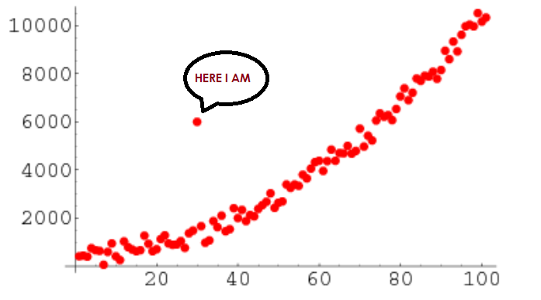
Outlier Analysis

Slide 12
Outlier
What is an outlier ?
Causes of Outliers ?
Mean = Most Common measure of Central Tendency
Mean Affected by Extreme Values

Slide 13
How to detect ?
Percentile & Quartiles
Box Plot

Slide 14
Normalization/ Feature Scaling
Normalization is the process of reducing unwanted variation either within or between variables

Slide 15
Example of feature Scaling

Slide 16
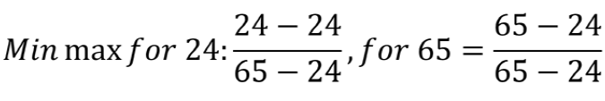
How to do Scaling ?
Range is 0 to 1

Slide 17

Standardization/Z-score

Slide 18
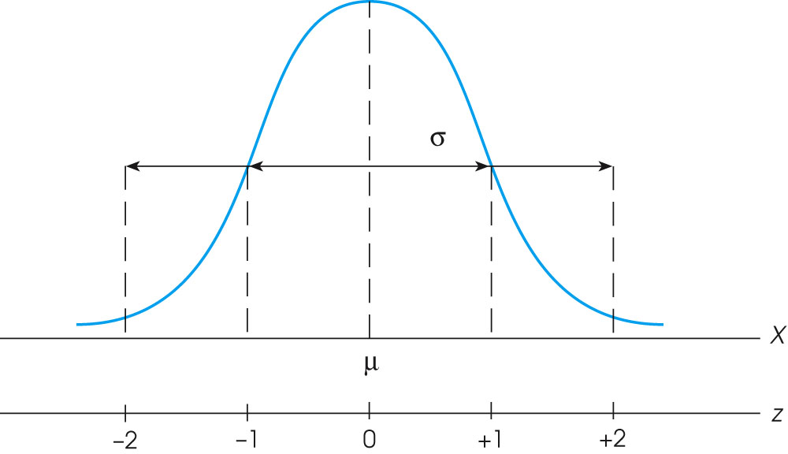
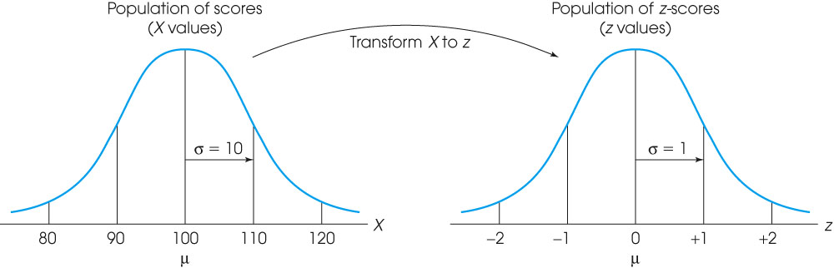

Slide 19
FIN.
Ask your doubts in comments Section
Notes:
Ask your doubts in comments Section

